Slide 1
AEROBIC DANCE

Slide 2
Definition: A form of rhythmic physical exercise that combines dance and aerobic movements, often set to music, aimed at improving cardiovascular fitness.
History: Aerobic dance became popular in the 1970s, largely due to fitness trends and figures like Jacki Sorensen and Jane Fonda. It was used as a fun and energetic way to promote health and weight loss.

Slide 3
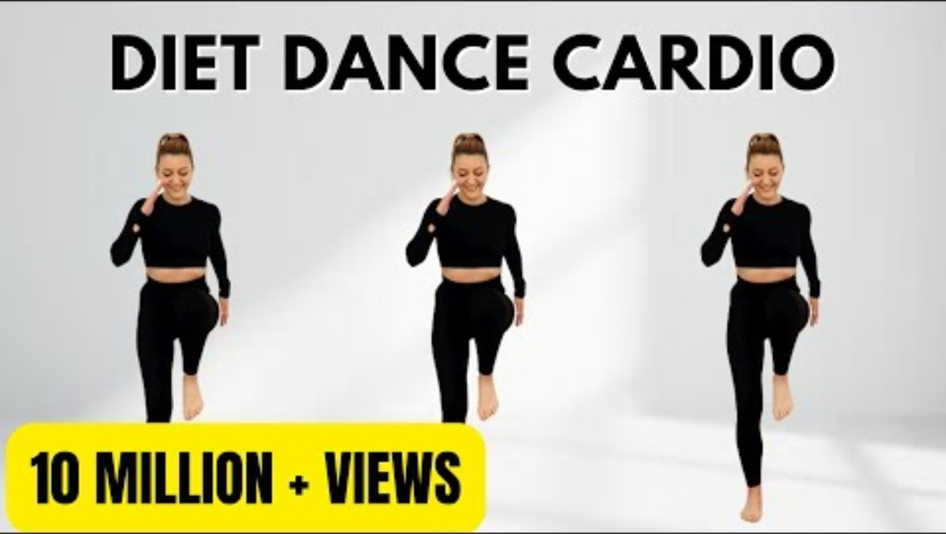
AEROBIC DANCE

Slide 4
MODERN DANCE

Slide 5
Definition: A broad genre of dance that emphasizes freedom of movement and personal expression, breaking away from the strict techniques of classical ballet.
History: Developed in the early 20th century by pioneers like Isadora Duncan, Ruth St. Denis, and Martha Graham. It was a rebellion against the rigid structure of ballet, focusing instead on natural movement and emotional expression.

Slide 6
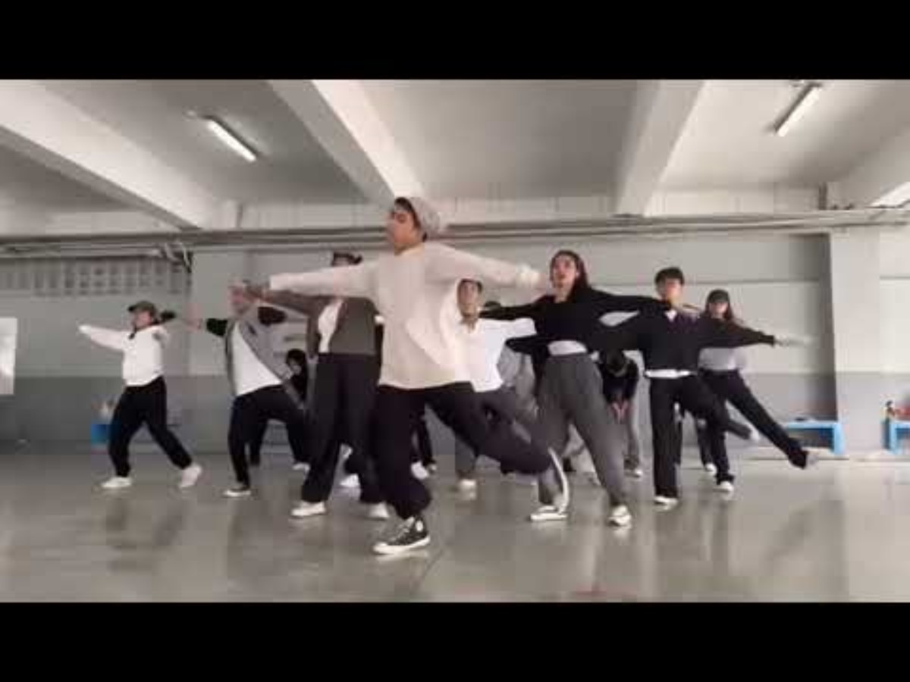
MODERN DANCE

Slide 7
HIP-HOP DANCE

Slide 8
Definition: A dynamic street dance style that includes a variety of moves such as breaking, popping, locking, and freestyle, performed to hip-hop music.
History: Originated in the Bronx, New York, during the 1970s. Hip-hop dance evolved alongside hip-hop culture, with breakdancing being one of its first expressions, later joined by other styles.

Slide 9
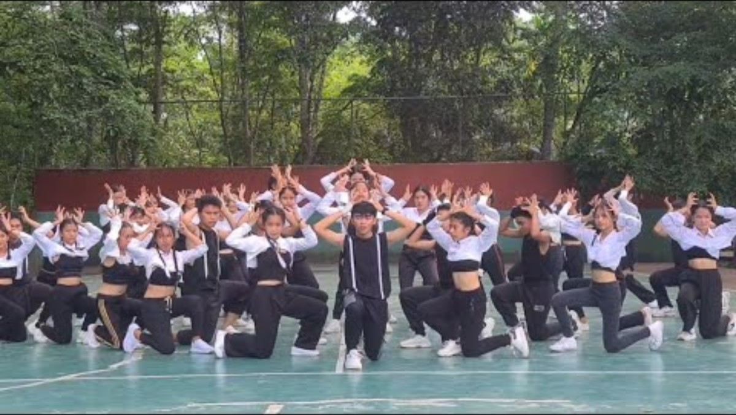
HIP-HOP DANCE

Slide 10
TUTTING

Slide 11
Definition: A style of hip-hop dance that involves sharp, angular movements of the arms and hands, forming geometric shapes, especially right angles.
History: Named after the Egyptian pharaoh Tutankhamun (“King Tut”), this style mimics the poses found in ancient Egyptian art. It gained popularity in the1980s within the popping and street dance communities.

Slide 12
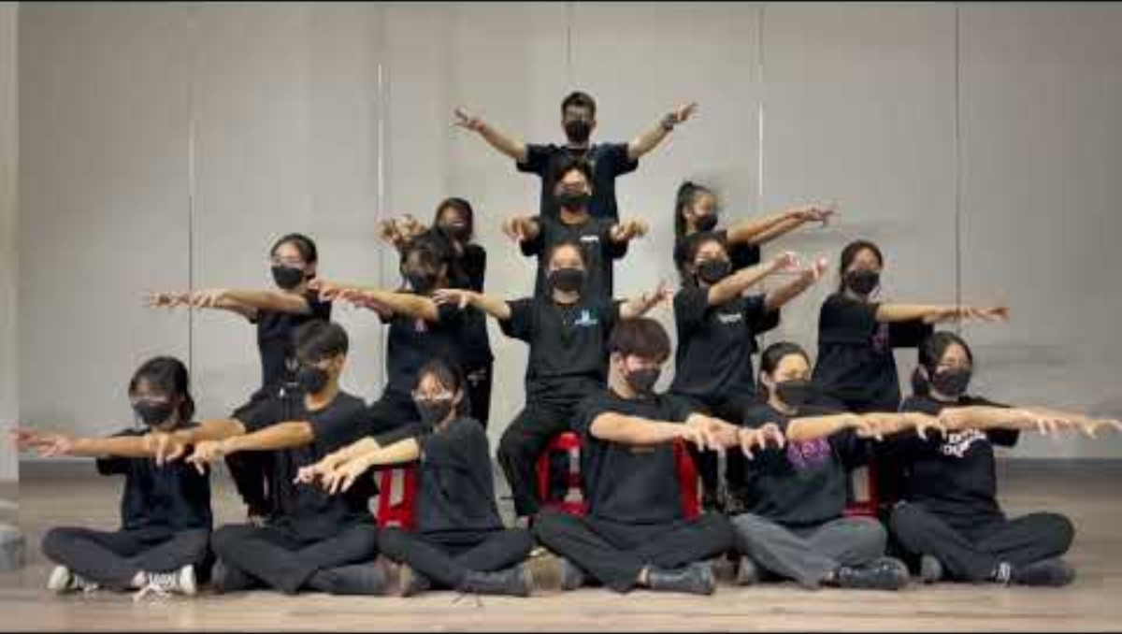
TUTTUNG DANCE

Slide 13
WHACKING

Slide 14
Definition: A rhythmic dance style characterized by fast arm movements, posing, and expressive performance, often to disco or funk music.
History: Originated in the LGBTQ+ clubs of Los Angeles during the 1970s. It was a form of self-expression for queer dancers and was heavily influenced by fashion, drag, and pop culture.

Slide 15
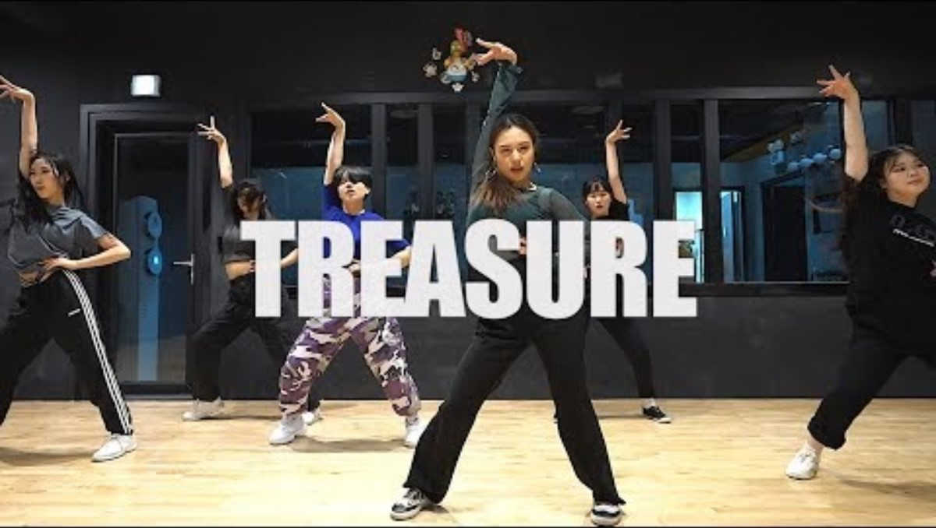
WACKING DANCE

Slide 16
KRUMPING

Slide 17
Definition: A highly energetic street dance style known for expressive, exaggerated, and aggressive movements that reflect deep emotion.
History: Developed in South Central Los Angeles in the early 2000s by youth as a positive outlet to escape gang violence. Pioneers include Tight Eyez (Ceasare Willis) and Big Mijo (Jo'Artis Ratti).

Slide 18
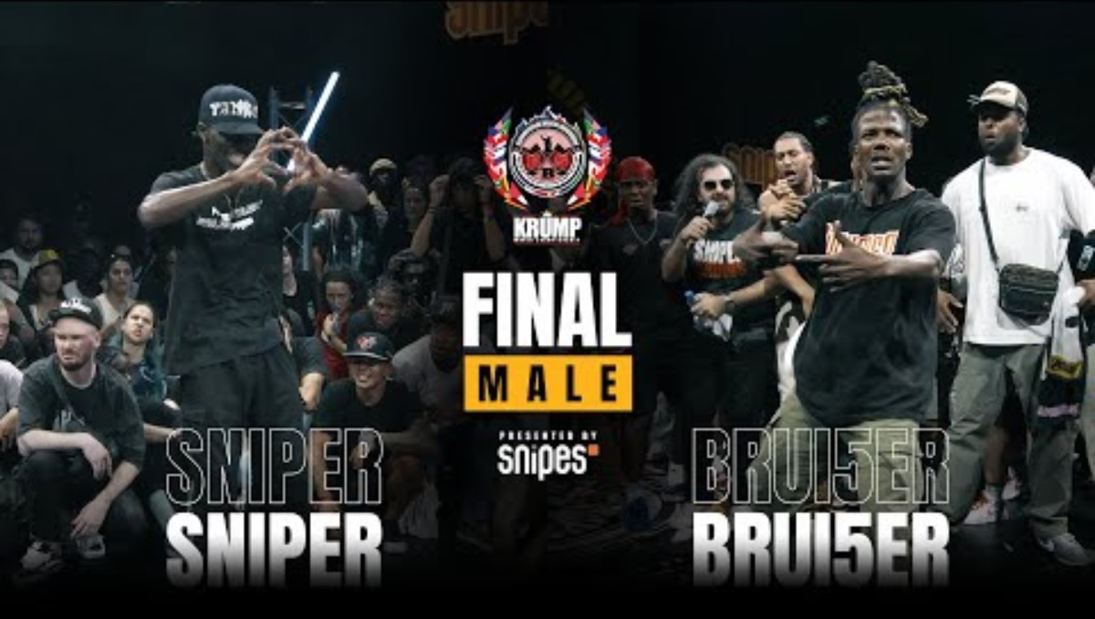
KRUMPING DANCE

Slide 19
CONTEMPORY
DANCE

Slide 20
Definition: A fusion dance genre that blends elements of modern, jazz, lyrical, and classical ballet, often focusing on emotion and storytelling.
History: Emerged in the mid-20th century as an evolution of modern dance. Dancers like Merce Cunningham and Martha Graham helped shape it by combining technical precision with expressive freedom.

Slide 21
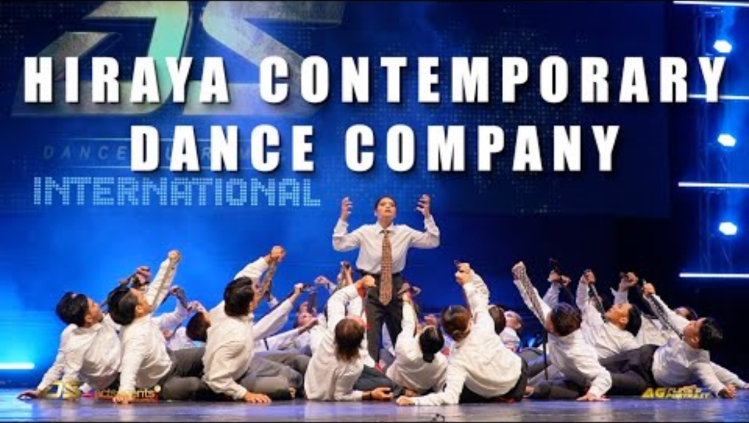
CONTEMPORARY DANCE

